Slide 1
Evaluation Guidelines
Arnaout H., Elbassuoni S.

Slide 2
Evaluation – PART 1
Assessment per result (subgraph)
Goal: Tuning Diversity Parameter

Slide 3
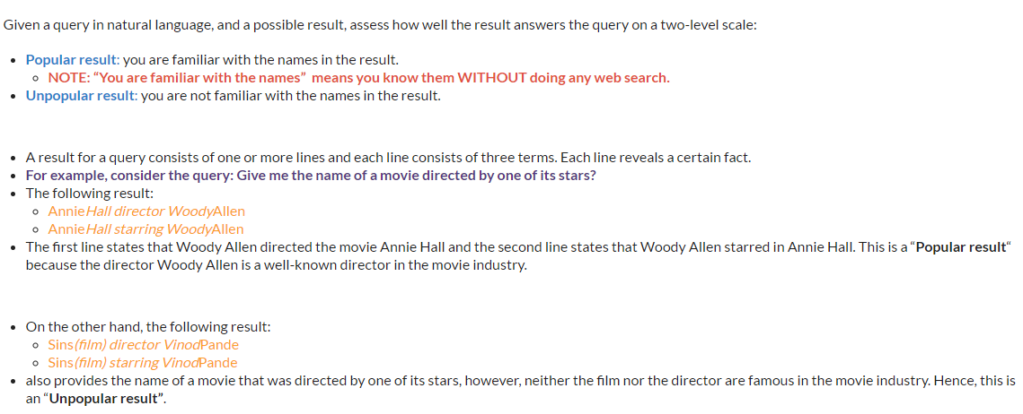
Guidelines for evaluating the relevance of a result Queries Type: Triple-pattern queries with many results

Slide 4
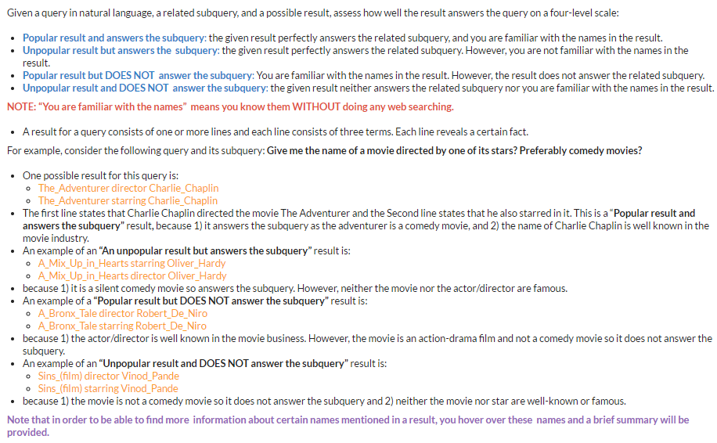
Guidelines for evaluating the relevance of a result Queries Type: Extended triple-pattern queries with many results

Slide 5
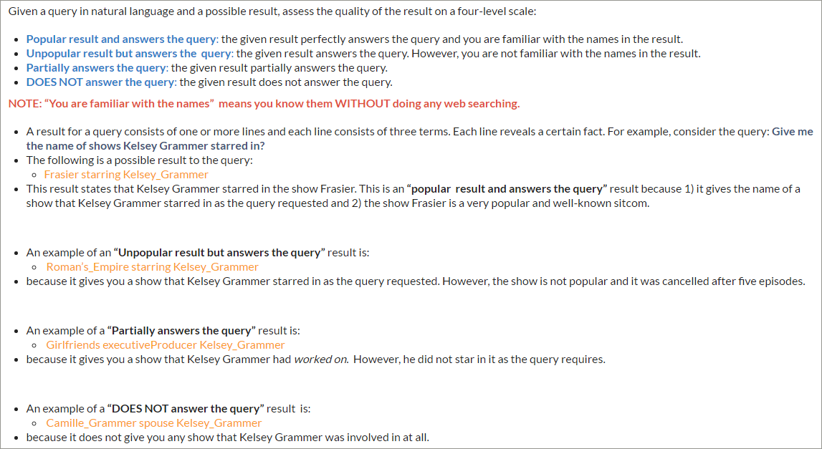
Guidelines for evaluating the relevance of a result Queries Type: Triple-pattern queries with zero results

Slide 6
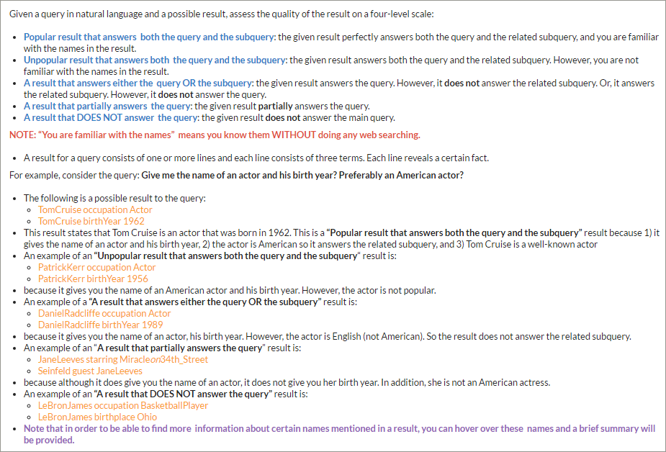
Guidelines for evaluating the relevance of a result Queries Type: Extended triple pattern queries with zero results

Slide 7
Evaluation – PART 2
Choosing the most relevant top-10 result set
Goal: Compare with competitors

Slide 8
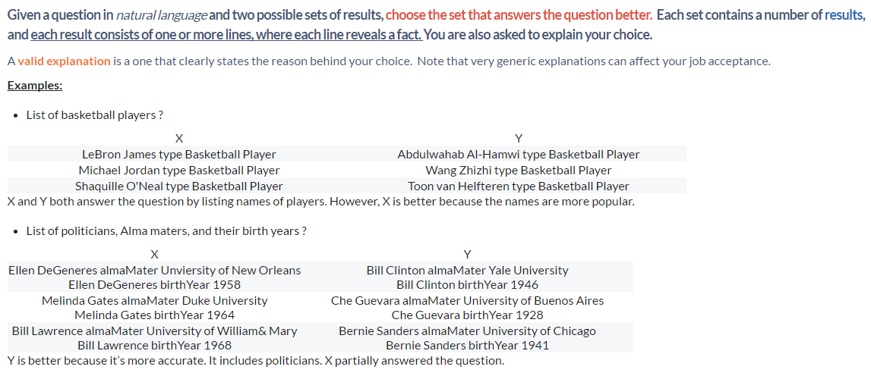
Guidelines for evaluating the relevance of a set of results Queries Type: All Types

Slide 9
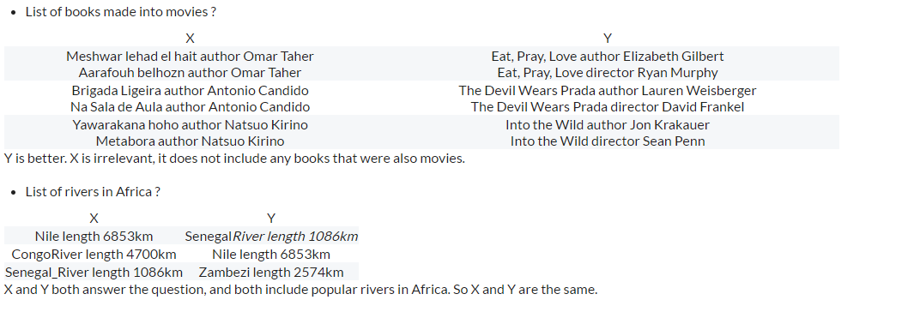
Guidelines for evaluating the relevance of a set of results Queries Type: All Types (cont’d)

Slide 10
Evaluation – PART 3
Choosing the most relevant & diverse top-10 set
Goal: Compare relevance-only approach with 3 notions of diversity

Slide 11
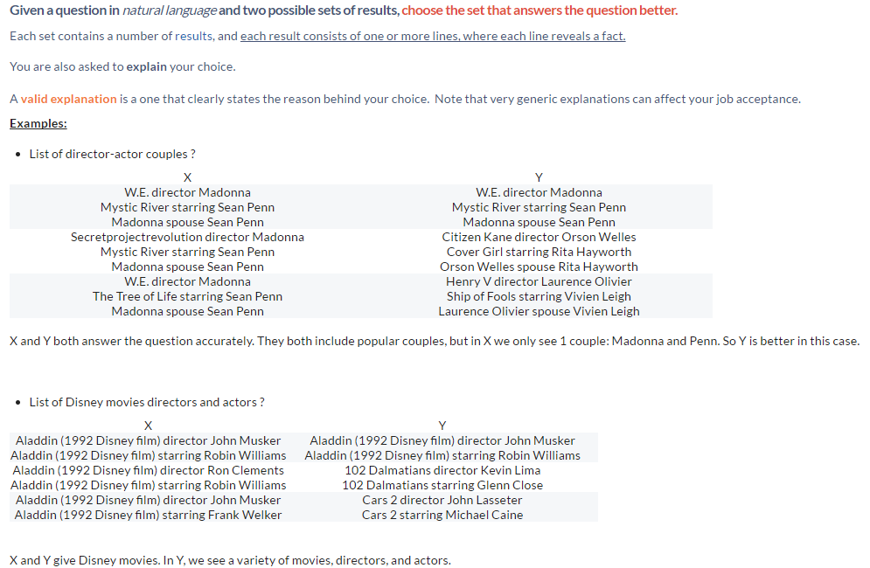
Guidelines for comparing relevance-only approach with Knowledge-graph-based and Query-based notions Queries Type: All Types

Slide 12
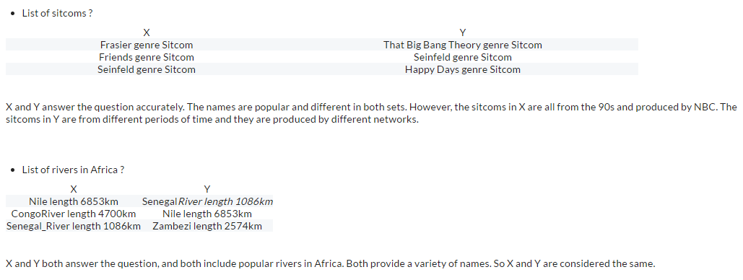
Guidelines for comparing relevance-only approach with Knowledge-graph-based and Query-based notions Queries Type: All Types (cont’d)

Slide 13
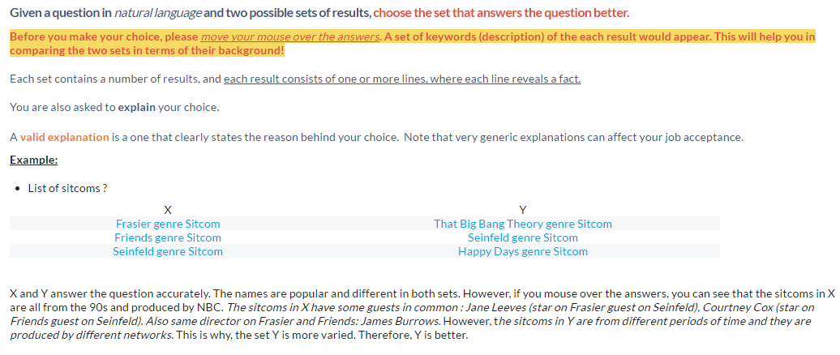
Guidelines for comparing relevance-only approach with Text-based notion Queries Type: All Types

